Slide 1


JS Applications
Course Overview
SoftUni Team
Technical Trainers
Software University
http://softuni.bg

Slide 2
Table of Content
Introduction
Training & Team
Course Objectives
Course Organization

Slide 3
Have a Question?
sli.do
#JS-CORE

Slide 4













SoftUni Diamond Partners

Slide 5




SoftUni Organizational Partners

Slide 6

JS Applications
Course Introduction

Slide 7
What are we going to learn?
In this course we are going to learn:
HTTP, REST Services, Postman
AJAX and jQuery AJAX
Asynchronous programming and promises
JS for front-end
Templating: creating UI with Handlebars
Routing with Sammy.js

Slide 8

Trainers and Team

Slide 9
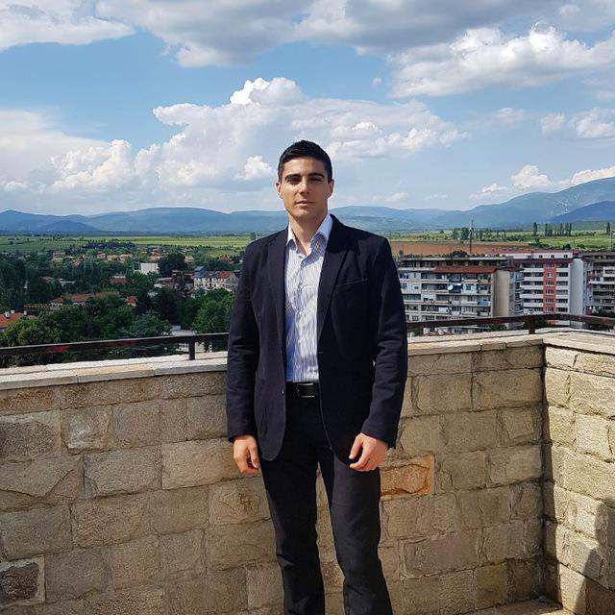
William Abboud
Full Stack & Senior Front-End Developer @ SoftUni
Studied Computer Science in Newcastle University
Passionate about Front-End Technologies (HTML/CSS/JS/React.js) and UX/UI Design

Slide 10
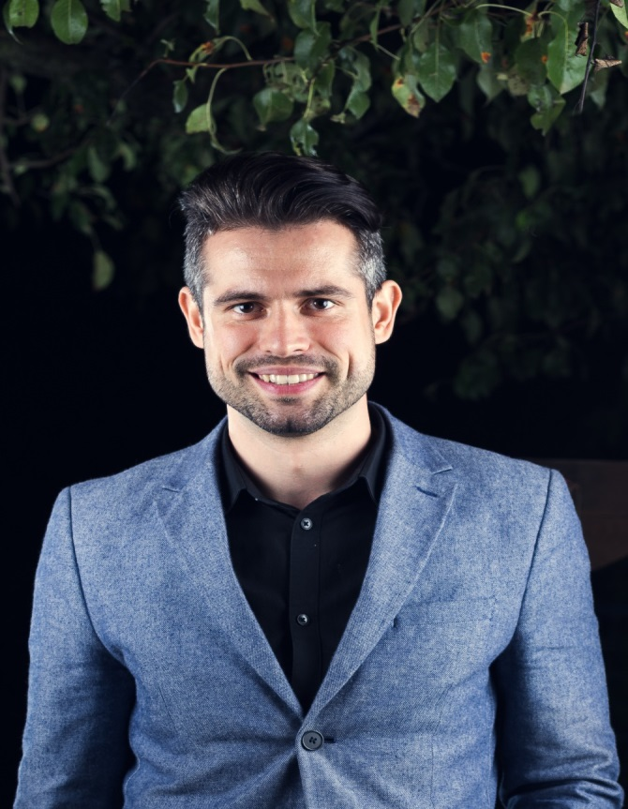
Ivaylo Papazov
Full-Stack Developer in SoftUni
Technical Trainer in SoftUni
Experience in JS, C#, Node.js, React, ASP.NET MVC
TelerikAcademy Graduate

Slide 11
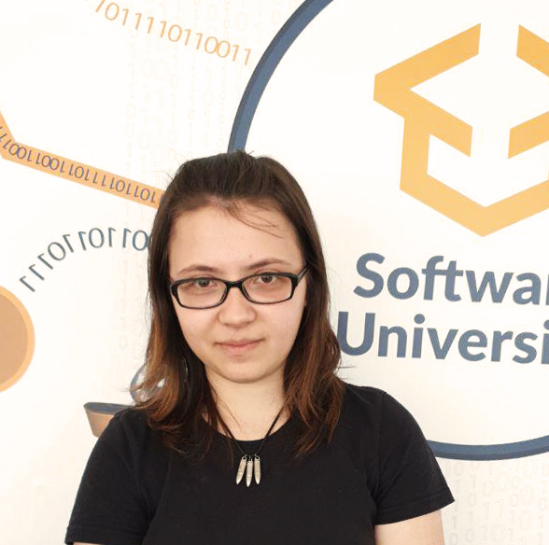
Tanya Staneva
Technical Trainer in SoftUni
SoftUni Top Student
Passionate about JavaScript technologies
Interested in AI and Algorithms
Loves solving puzzles and increasing her the problem solving skills

Slide 12

Behind the Scenes
The team working on the materials:
Antoniya Atanasova
Bilyana Borislavova
Hristomir Asenov

Slide 13

Course Objectives
Course Details and Schedule

Slide 14
Targets of the Course
The JS Applications course provides
Consuming RESTful Services (REST) with AJAX
Technologies for creating Single Page Apps (SPA)
Creating UI templates
Common JS programming patterns and routing

Slide 15
Exam
Link to last JS-Applications exam: https://judge.softuni.bg/Contests/Practice/Index/1410#0
Structure: SPA (Single Page Application) for 6 hours
Implement CRUD operations + login / register / logout
Use AJAX and REST + cloud-based back-end (Kinvey)
Optionally:
Use templates for rendering
Use MVC architecture + routing

Slide 16

Course Organization

Slide 17

Structure of the Course
Lectures:
Twice a week (4 hours each)
Learn new material
Exercises:
Twice a week (4 hours each)
Practice learned material
Ask questions if any

Slide 18

Evaluation Criteria
Mandatory:
Final exam - 90%
Exercises & homework - 10%
Bonuses:
Presence in class - 5% bonus
Forum activity - bonus up to 5%

Slide 19
https://softuni.bg/courses/js-apps

Slide 20




Trainings @ Software University (SoftUni)
Software University - High-Quality Education and Employment Opportunities
softuni.bg
Software University Foundation
http://softuni.foundation/
Software University @ Facebook
facebook.com/SoftwareUniversity
Software University Forums
forum.softuni.bg

Slide 21

License
This course (slides, examples, demos, videos, homework, etc.) is licensed under the "Creative Commons Attribution-NonCommercial-ShareAlike 4.0 International" license

